Slide 1
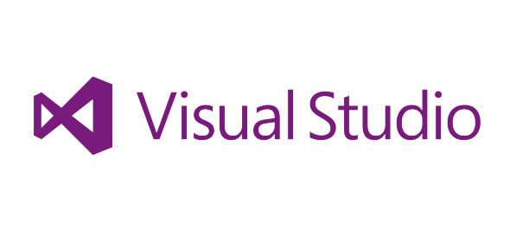
An Introduction to ASP.NET MVC

Slide 2

What is MVC?
MVC is a paradigm or a design pattern for relating user interface to underlying data models
MVC Originated in SmallTalk
1970s (Thing-Model-View-Editor)
Popularized for RoR in 2003

Slide 3
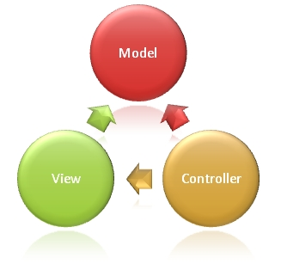
MVC Components
Notes:
MVC AS A USER INTERFACE PATTERN

Slide 4
The Model
The Model , which represents the underlying, logical structure of data in a software application and the high-level class associated with it. This object model does not contain any information about the user interface.

Slide 5
The View
The View , which is a collection of classes representing the elements in the user interface (all of the things the user can see and respond to on the screen, such as buttons, display boxes, and so forth)

Slide 6
The Controller
The Controller , which represents the classes connecting the model and the view, and is used to communicate between classes in the model and view.

Slide 7
Models, Views, and Controllers
What does MVC look like?
Request
Controller
Controller
Retrieves Model
“Does Stuff”

Model

Response
View
View
Visually represents
the model


Slide 8
Seems complicated. What’s the point?
“Separation of Concerns” The most important purpose of the MVC design pattern is to separate content from presentation and data-processing from content
Every web application needs some structure
MVC helps you stay organized, start to finish
Often end up with less code, not more
Smoother learning curve as your project grows

Slide 9
MVC vs Web Forms
MVC vs Web Forms
Which one?

Slide 10
ASP.NET Web Forms Values
Productive way to build web applications
Control and event-based programming model
Controls that abstract HTML, JS and CSS
Rich UI controls – datagrids, charts, Ajax
Browser differences are handled for you
Summary: Web Forms handles a lot of things for you.
Notes:
Web Forms: it was simple – drag and drop

Slide 11
ASP.NET MVC Advantages
Enables the full control over the rendered HTML.
Provides clean separation of concerns(SoC).
Enables Test Driven Development (TDD).
Easy integration with JavaScript frameworks.
Following the design of stateless nature of the web.
RESTful urls that enables SEO.
No ViewState and PostBack events

Slide 12
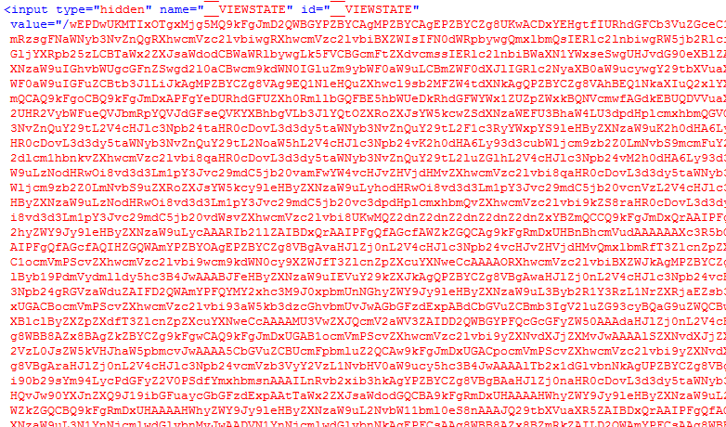
ViewState ☹
Notes:
ViewState: the way the controls work, they are handling sate for you.

Slide 13
Controlling over HTML
<select name="ctl00$uxLanguageSelector$uxLanguageSelector" onchange="javascript:setTimeout('__doPostBack(\'ctl00$uxLanguageSelector$uxLanguageSelector\',\'\')', 0)" id="ctl00_uxLanguageSelector_uxLanguageSelector" class="countrySelect">
Notes:
Generating bad HTML
You don’t have direct control over IDs and classes

Slide 14
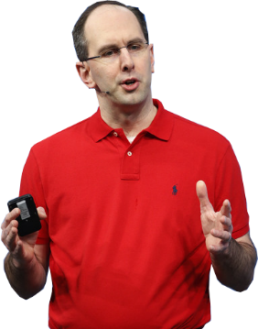
ASP.NET MVC History
ASP.NET MVC 1 – 2009
ASP.NET MVC 2 - 2010
ASP.NET MVC 3 – 10 months later
ASP.NET MVC 4
ASP.NET MVC 5 – 2013
ASP.NET Core 1.0 – Completely a new Animal
Notes:
In February 2007, Scott Guthrie (“ScottGu”) of Microsoft sketched out the core of ASP.NET MVC while ﬂying on a plane to a conference on the East Coast of the United States.

Slide 15
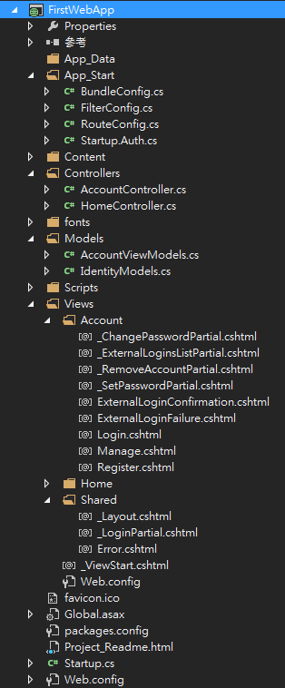
Convention over Configuration
Project structure
Easy to find
Naming Rules

Slide 16
One ASP.NET
Sites
Services
Web
Forms
Web
Pages
Single
Page
Apps
MVC
Web
API
SignalR
ASP.NET

Slide 17
One ASP.NET
Sites
Services
YOU!
Web
Forms
Web
Pages
Single
Page
Apps
MVC
Web
API
SignalR
YOU!
ASP.NET

Slide 18
One ASP.NET
Sites
Services
YOU!
Web
Forms
Web
Pages
Single
Page
Apps
MVC
Web
API
SignalR
YOU!
ASP.NET

Slide 19
ASP.NET MVC Blocks
Model Binding
IoC Support
View Model
Security
Validation
jQuery
UI Templates
Open-Source Tools

Slide 20
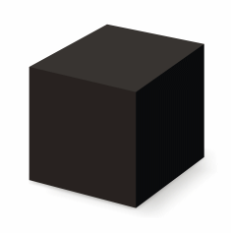

ASP.NET WebForms
ASP.NET MVC

Slide 21
ViewEngins
The view engine is responsible for creating HTML from your views. Views are usually some kind of mixup of HTML and a programming language
ASPX
Razor
Spark
NHaml
NDJango
Hasic
…
Razor View Engine sample
<div>@Model.UserName</div>.

Slide 22
Layout, View and Partial View
A partial view is a "sub-view" that you embed within a main view something that you might reuse across multiple views, like a sidebar.
The layout view allows you to define a common site template like master page in asp.net web forms

Slide 23
Display and Editor Templates
Display and Editor templates are used to standardize the layout shown to the user when editing or displaying certain types or classes
Default View for specific type that can be customized by our view like how to represent date

Slide 24
Action، ActionResult
Action is a method that is called by user request like /Home/Index
Action Result is a return type of a action method or in short it is a response to the client

Slide 25
Data Model Binding
Model binding in ASP.NET Core MVC maps data from HTTP requests to action method parameters the parameters may be simple types such as strings, integers, or floats, or they may be complex types

Slide 26
Hello ASP.NET MVC

